Slide 1

AP-S/URSI — Technical Workshop HD-7
AI in Antenna Design and Analysis: From
Pretrained Models to System-Level Integration
Overview
Sudarshan Sivaramakrishnan – ssivaram@mathworks.com
Principal Software Engineer
MathWorks | RF/EM Group
Notes:
Build the RF digital twin of a beamformer from OTA measurements and with hardware knowledge coming from the datasheet.
Use the digital twin for system-level integration and exploration of different applications.
This work is based on the model of the Fujikura Type-C PAAM integrated beamformer:
MW96-11-22-0008(11)_Type-C_Brochure.pdf

Slide 2
Agenda AI workflows for antenna design, analysis, and optimization
Challenges:
Electromagnetic analysis is very time consuming
Simulations and measurements generate a lot of fragmented data
Antenna designers might not be familiar with AI
Solutions and benefits:
Pre-trained AI antenna catalog objects
Faster design and analysis compared to EM techniques
Deep learning network for reconstructing 3D patterns from 2D measurements
Model antennas from limited measurements or datasheets
More accurate than analytical techniques
AI-powered optimization techniques
Faster optimization for antennas with many parameters
Notes:
So what are these problems that designers face?
Electromagnetic analysis can be very time consuming, especially when you need to perform it several times, like in an optimization
Simulations and measurements generate a lot of fragmented data
Antenna designers might not be familiar with AI
<click>
What I going to show you is how ML and AI can help in addressing these problems with:
Pre-trained AI antenna catalog objects for faster design and analysis compared to EM techniques
Deep learning network for reconstructing 3D far field radiation patterns from 2D measurements
AI-powered optimization techniques for antennas with many design parameters
Last, I will also show how to:
Perform electromagnetic analysis, import measured data, integrate for system-level simulation in the same environment

Slide 3
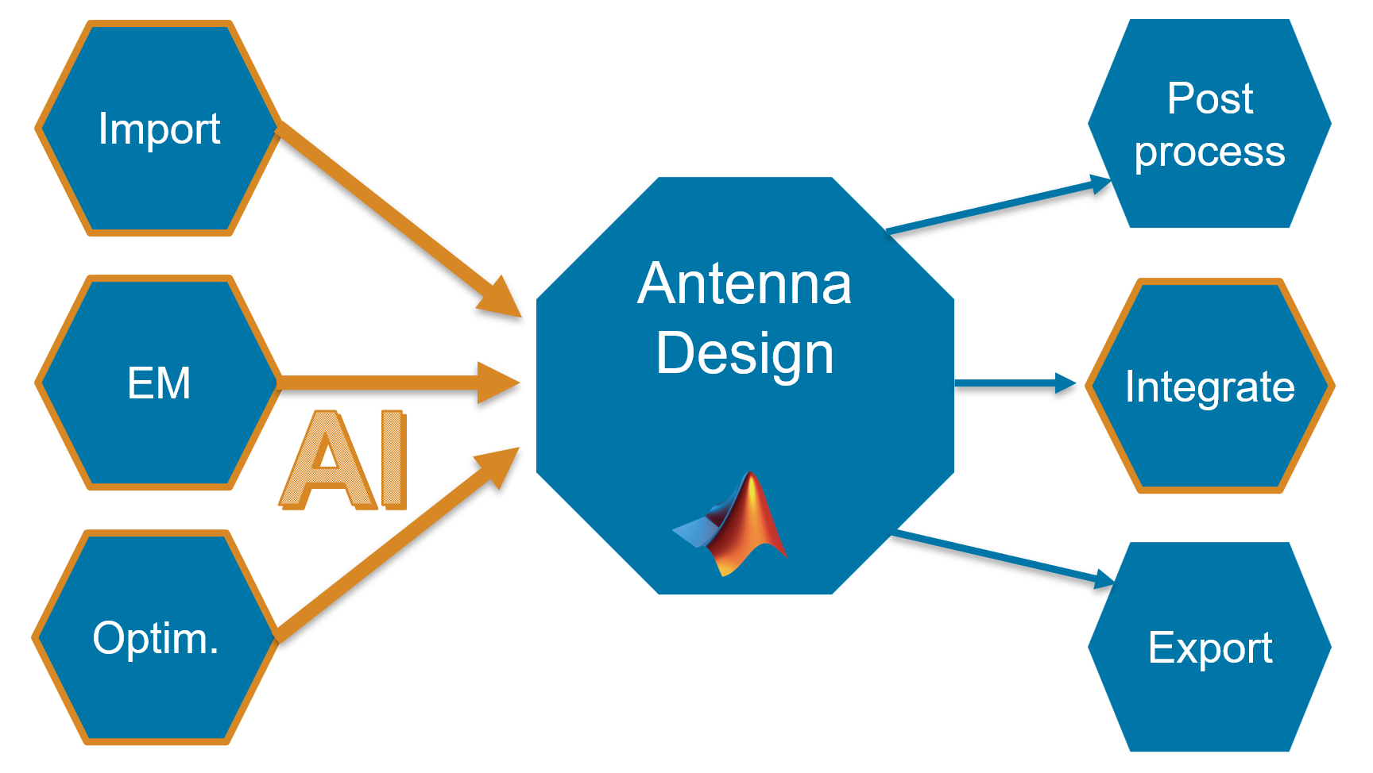
Conclusions: Using AI for Accelerating Antenna Analysis and Simulation with MATLAB
Pre-trained AI antenna catalog objects for faster design and analysis compared to EM techniques
Deep learning network for reconstructing 3D far field radiation patterns from 2D measurements
AI-powered optimization techniques for antennas with many design parameters
Perform antenna analysis, import measured data, optimize performance, and integrate for system-level simulation in the same environment
Notes:
At last, I’d like to conclude bringing it all together.
In MATLAB you find objects and function that allow you to speed up design and simulation, starting from EM analysis, to data import and optimization and system-level simulation.

